Slide 1
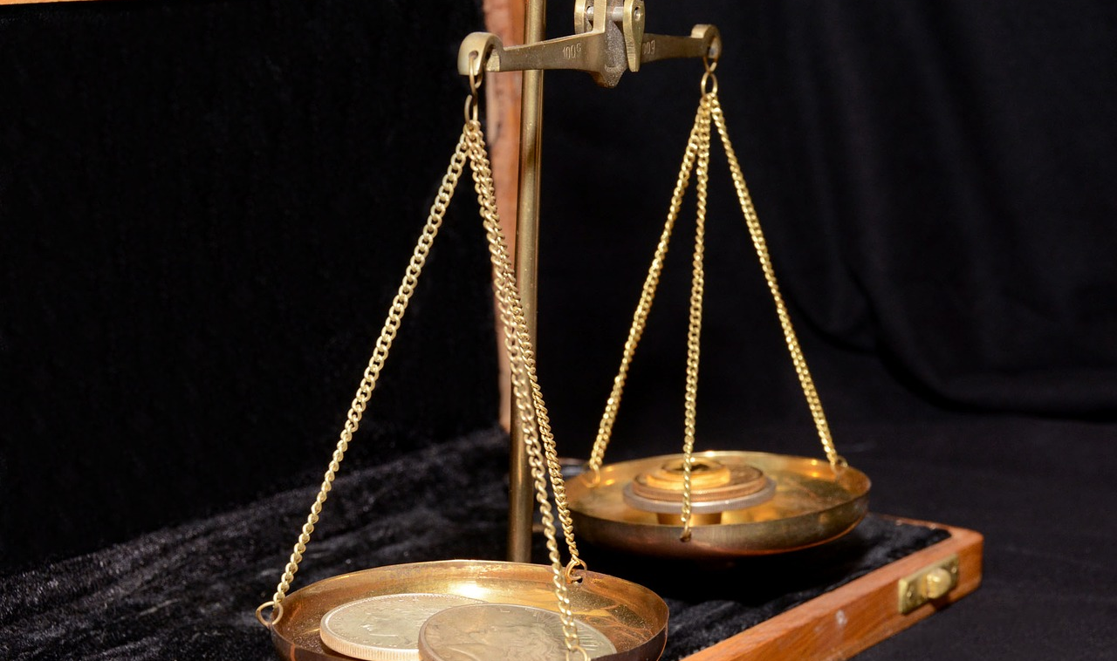
Intro to Data-Engineering – Privacy & Ethics Lecture
Dr. Michael Fire
mickyfi@bgu.ac.il
Notes:
See also
http://hanj.cs.illinois.edu/bk3/bk3_slidesindex.htm
Science Documentary 2016 | Big Data

Slide 2
What is Ethics
Ethics is a branch of philosophy that deals with moral principles and values. It is concerned with how people ought to behave, and what is right or wrong.

Slide 3
Data Science & Ethics
Privacy - Data science can involve collecting and analyzing personal information, which raises privacy concerns. It is important to handle this data with respect for people's privacy.
Bias - Data science algorithms can produce biased results if the training data is biased, leading to unfair treatment of certain groups. It's important for data scientists to be aware of and address bias in their work.
Transparency - Data scientists should be transparent about their methods to allow for understanding and verification. This is especially important when their work could have significant consequences, such as in criminal justice or lending/employment Decisions
Responsibility - Data scientists should use their skills ethically and act with integrity, considering the potential consequences of their work

Slide 4
BUGS & Feedback Loops

Slide 5
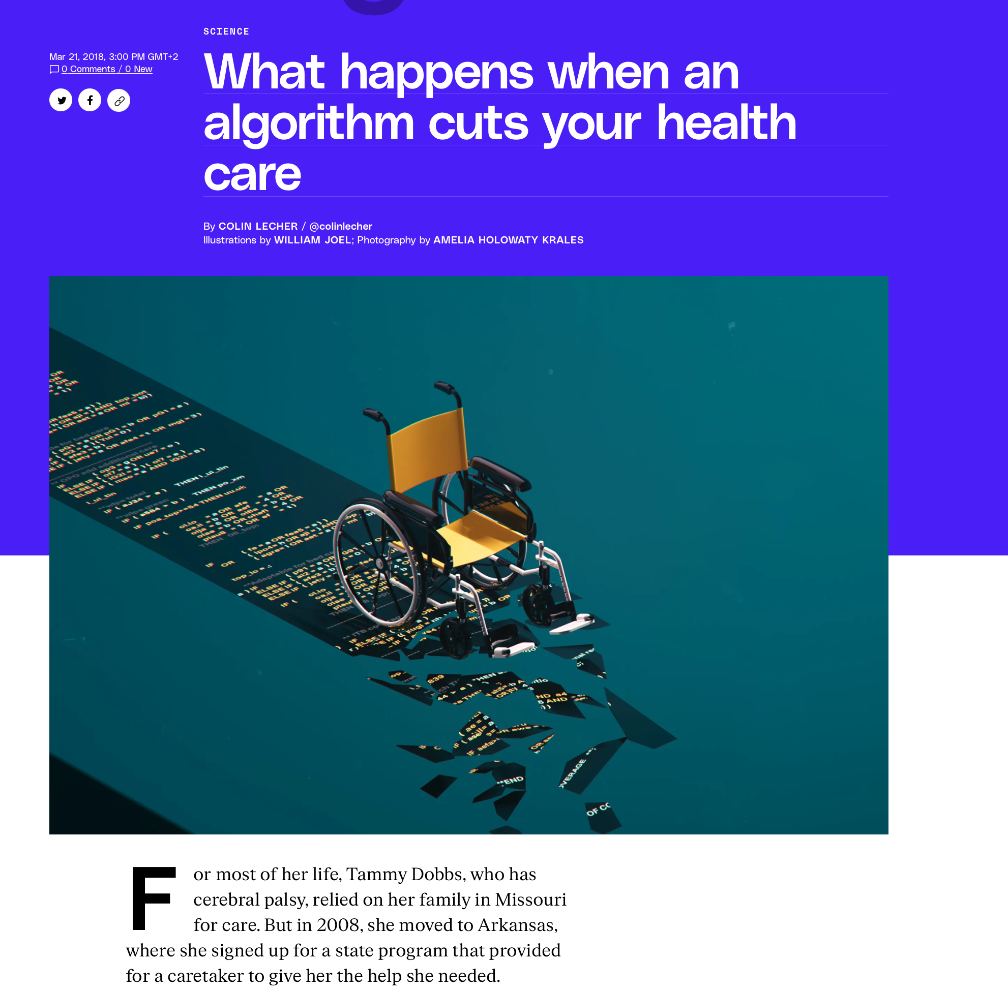
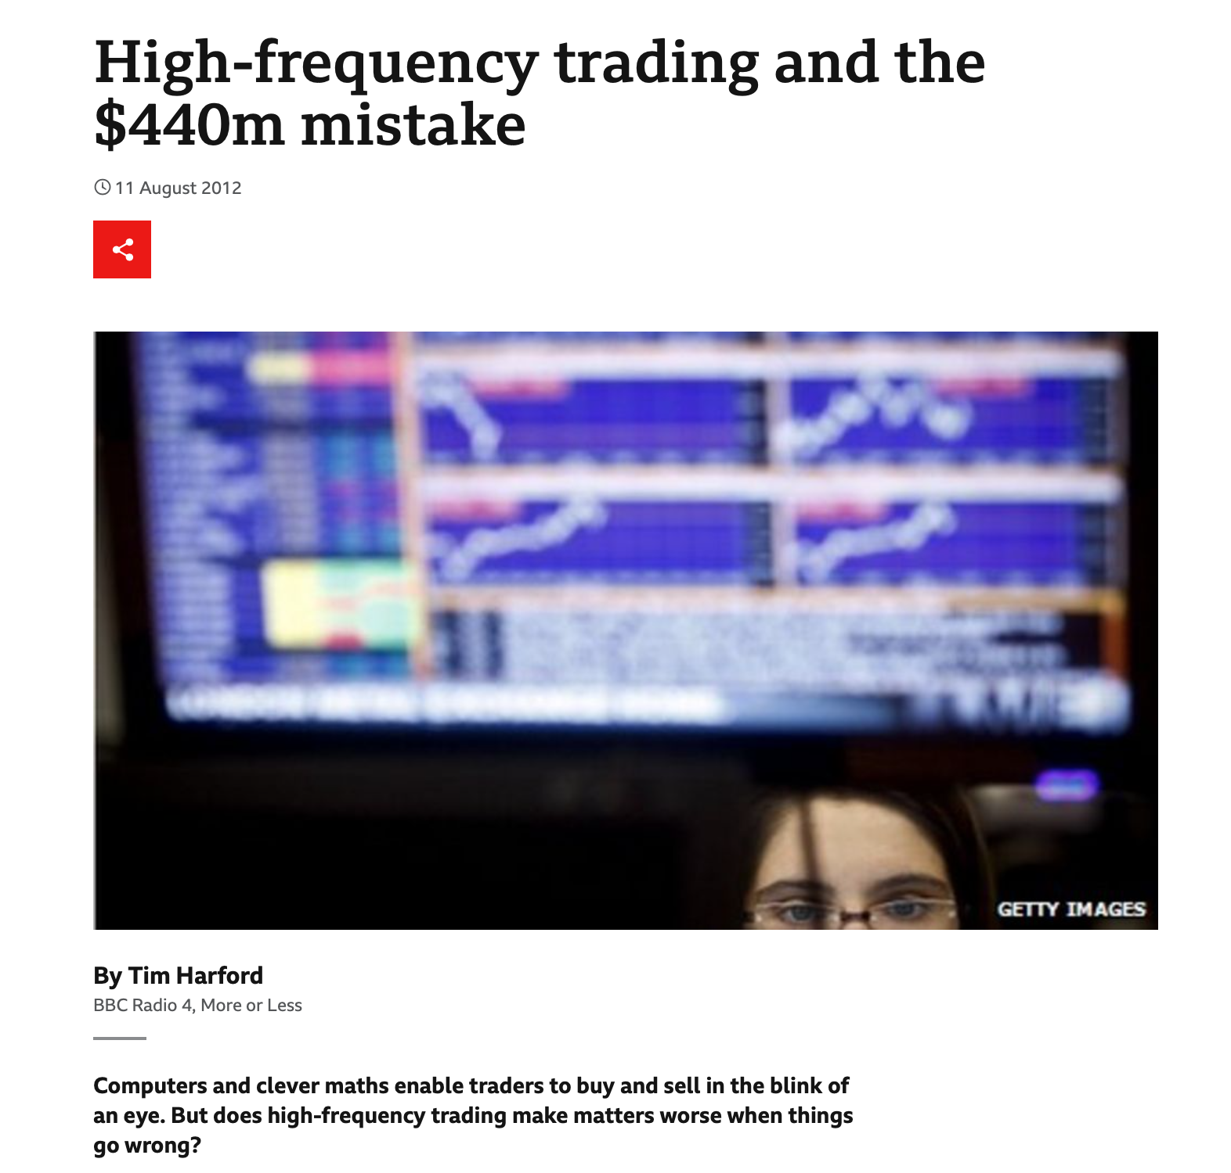
What harm a little code bug can do?
Notes:
https://www.abacademies.org/articles/health-insurance-and-algorithms-an-ethical-overview-13364.html
https://www.bbc.com/news/magazine-19214294
https://www.theverge.com/2018/3/21/17144260/healthcare-medicaid-algorithm-arkansas-cerebral-palsy

Slide 6
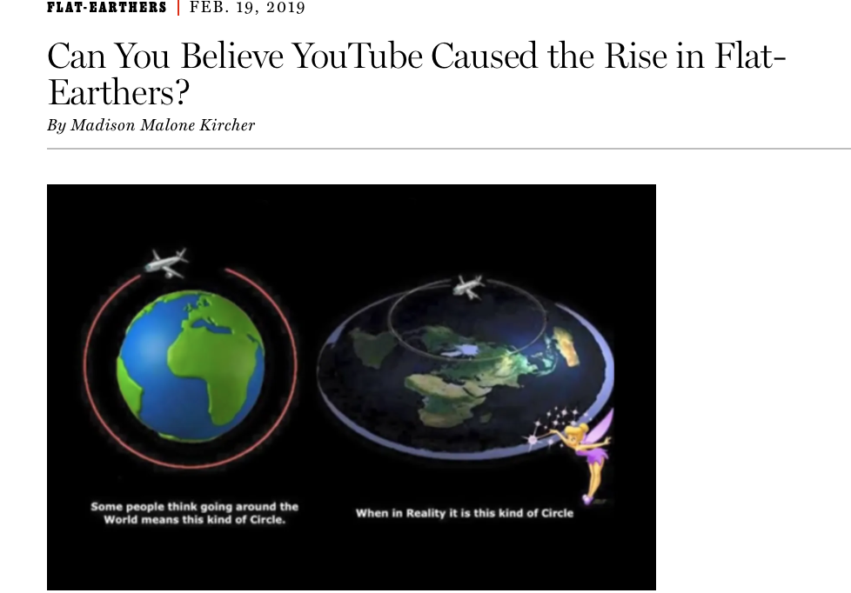
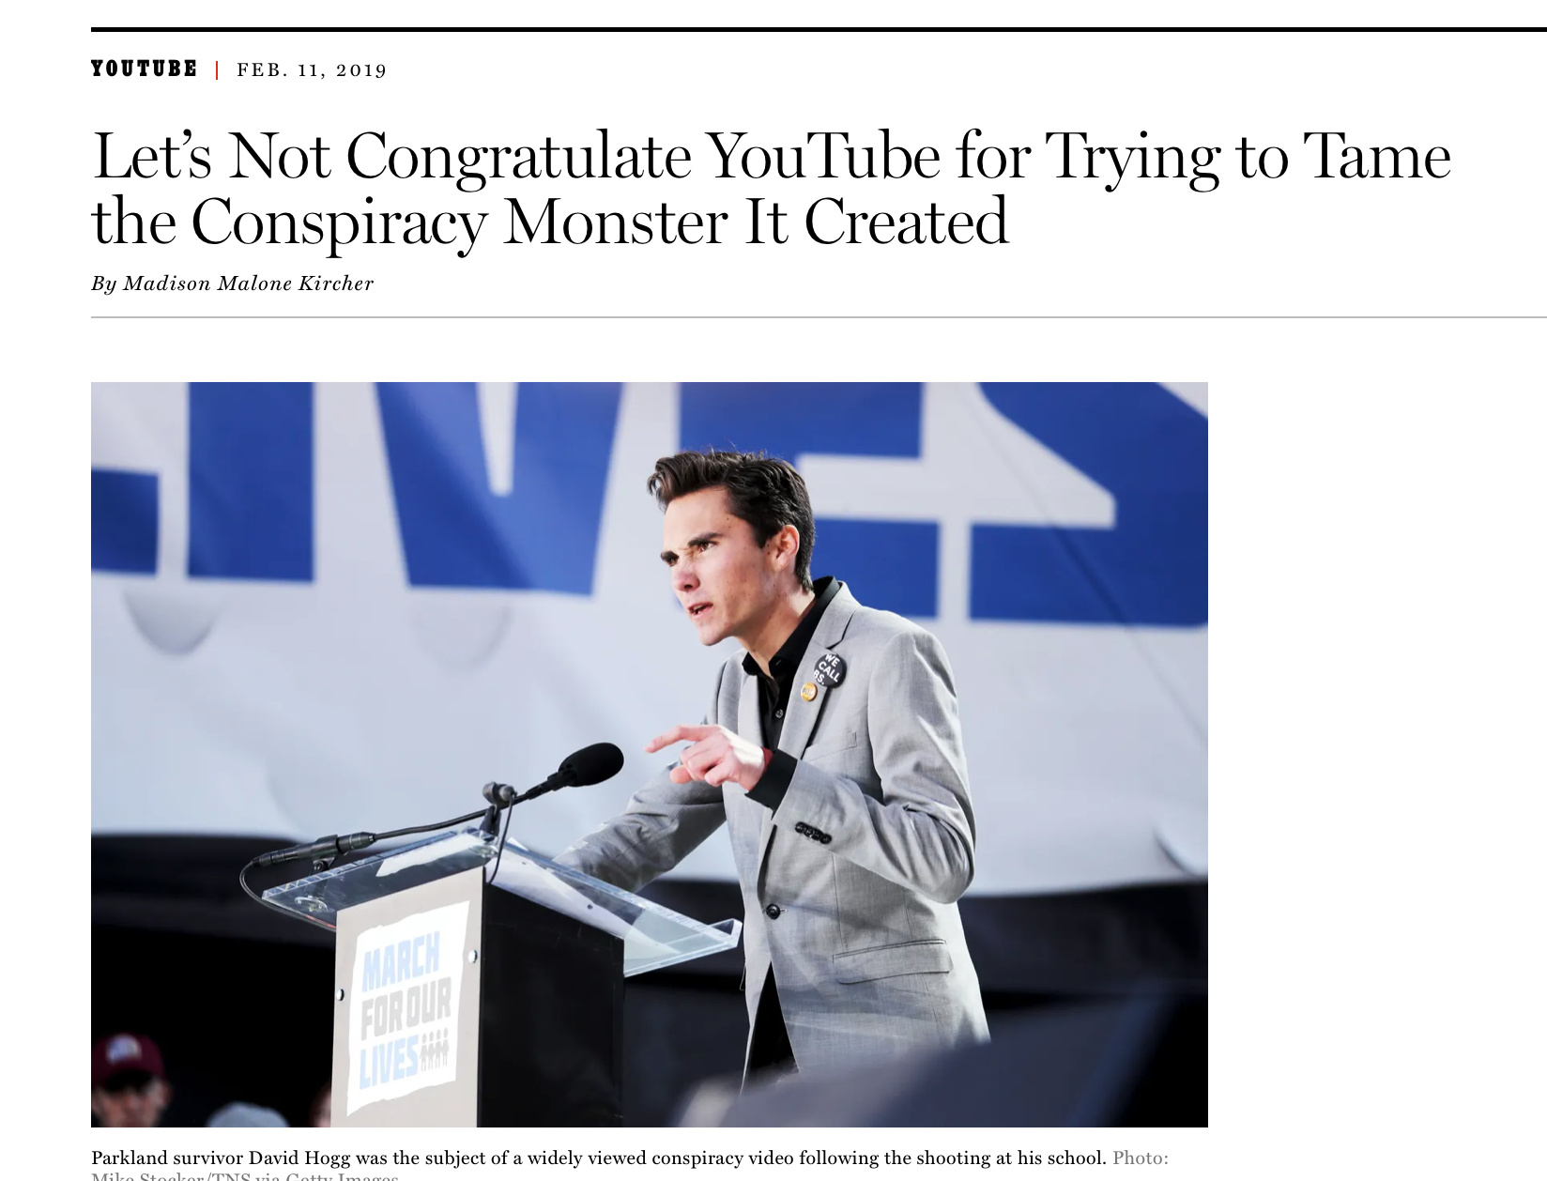
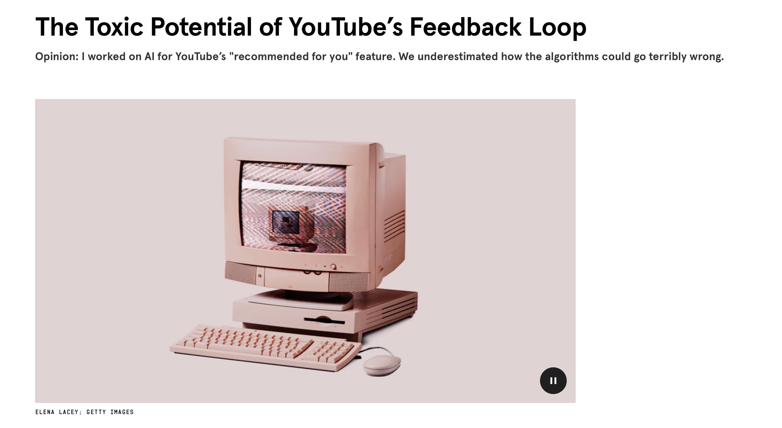
What harm can feedback loops can do?
Notes:
https://www.wired.com/story/the-toxic-potential-of-youtubes-feedback-loop/
https://nymag.com/intelligencer/2019/02/can-you-believe-youtube-caused-the-rise-in-flat-earthers.html

Slide 7
Privacy
Gil, Yolanda (Ed.) Introduction to Computational Thinking and Data Science. Available from http://www.datascience4all.org

Slide 8
The Rise of Privacy Concerns
- Science:
benefits of sharing clinical patient records
patients shall control access to their records
patients found to be altruistic:
willing to grant access for purpose of advancing science
- Government:
government and commercial use of data mining raises concerns
about appropriate use of private citizen information,
e.g., data collected for the purpose of airline passenger screening
should not be used for the enforcement of other criminal laws
-Open Web:
many users are happy to share private details on social webs
but would be rightfully upset was this data used for other purposes
content is shared between networks
not very transparent to the user
users need to be reassured about appropriate use of their data
Credit: http://www.datascience4all.org/

Slide 9
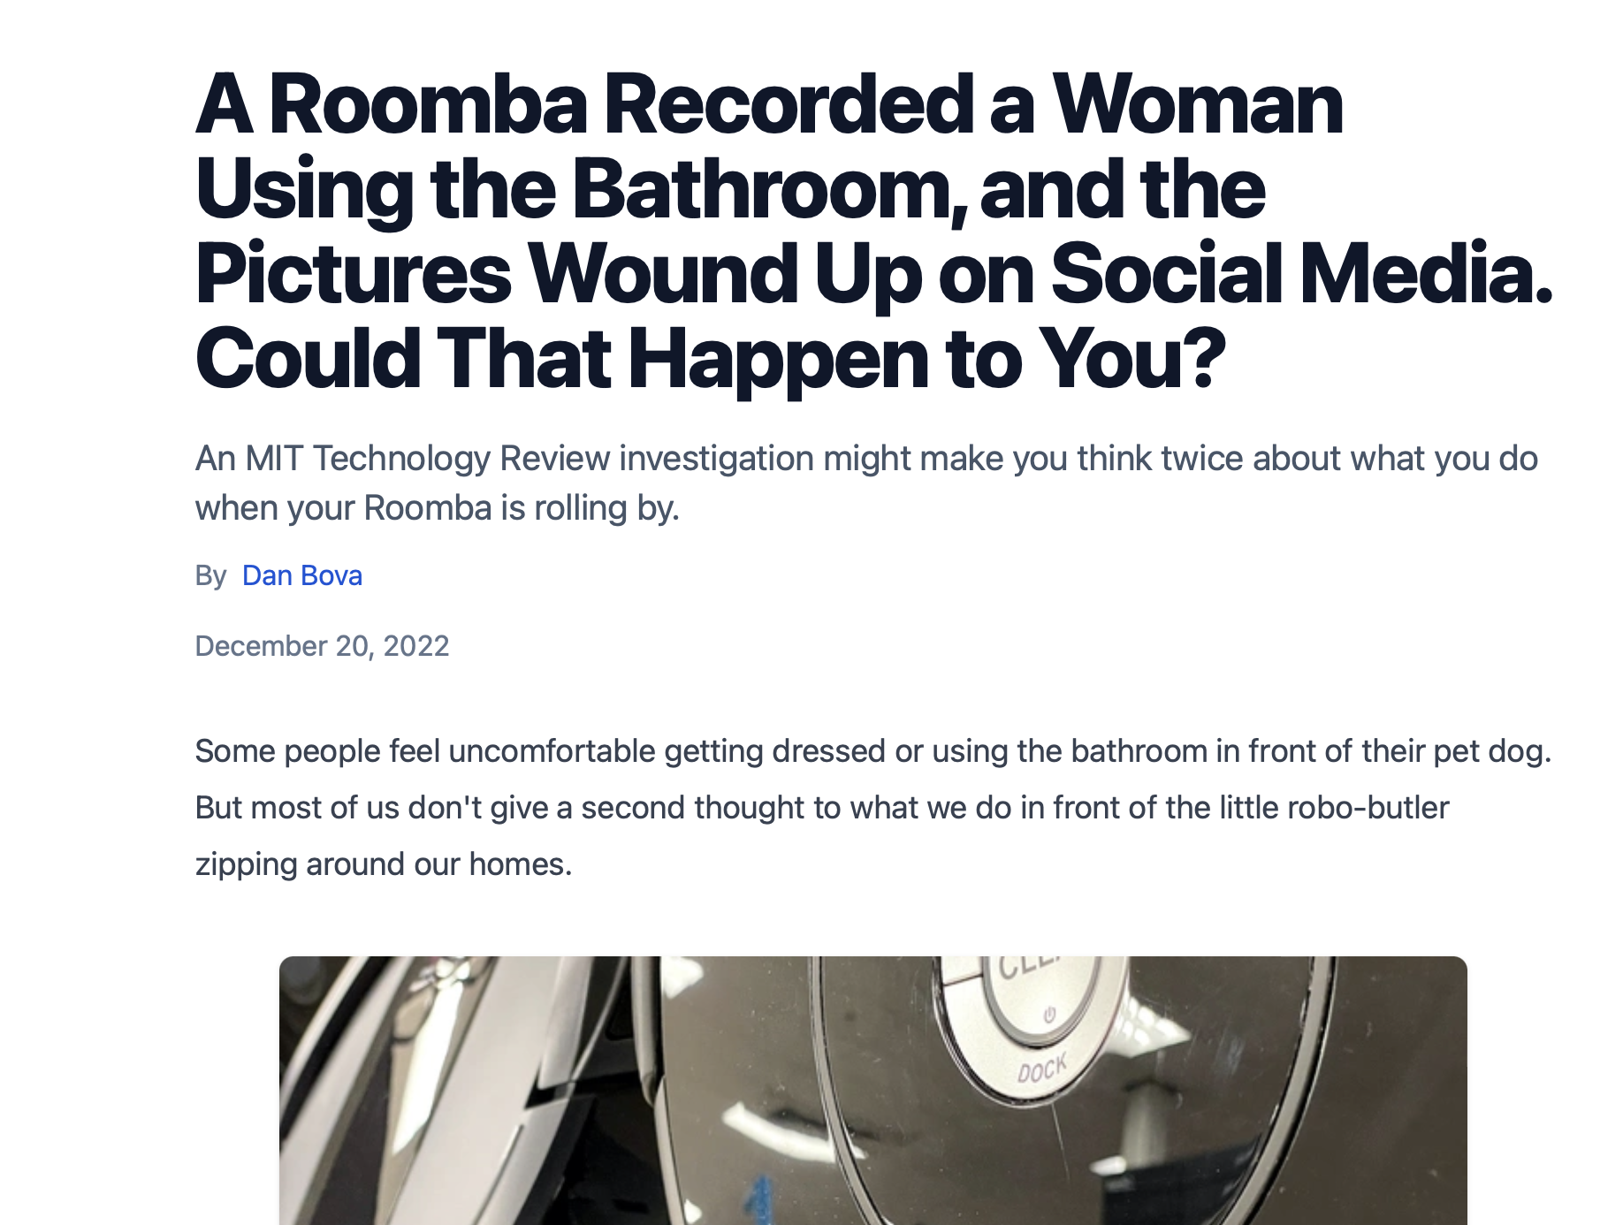

Slide 10
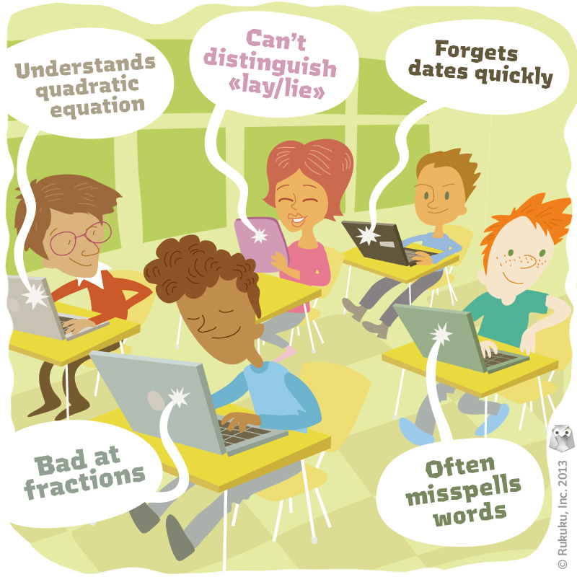

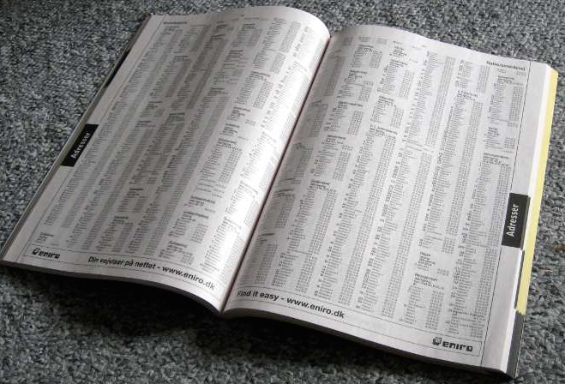
Private and Sensitive Data
http://www.rukuku.com/blog/wp-content/uploads/student-data-and-personalization.jpg
http://www.crimeoff24.com/?p=4869
https://en.wikipedia.org/?title=Telephone_directory#/media/File:Telefonbog_ubt-1.JPG
Credit: http://www.datascience4all.org/

Slide 11
Sensitive Data and Privacy
Sensitive Data
Privacy
Desire to limit the dissemination of sensitive data
Lots of technology, but:
Unclear requirements
Unclear behaviors
Data about individuals and organizations that should not be freely disseminated and
publicized
Health
Education
Finance
Demographic
Criminal
Location
Behavior
Credit: http://www.datascience4all.org/

Slide 12
Sensitive Data
identifying values
sensitive attribute
Credit: http://www.datascience4all.org/

Slide 13
OECD’s Eight Principles of Fair Information Practices [OECD 1980]
A framework for privacy protection
Protect use
Collection for a purpose
Use only for authorized purpose
Accountability throughout these principles
Credit: http://www.datascience4all.org/

Slide 14
Anonymization Techniques
Replace identifiers with randomly-generated identifiers
Eg: “Jane Krakowski” -> “Patient6479”
Abstraction: Replace values by ranges
Eg: Check-in date: 3/1/16 -> Check-in date: Spring 2016
Eg: Replace zip code by state
Cluster data points and replace individuals by their cluster centroid
Eg Ages: 21, 25, 28, 27, 18 -> 5 individuals with nominal
age of 24
Remove values
Eg: Omit birth date
Credit: http://www.datascience4all.org/

Slide 15
Problems with Anonymization Techniques
Limited use for research
Too coarse-grained
Re-identification
Re-identification is often trivial
E.g., anomymized list of students admitted showing undergraduate university and average GPA
Re-identification is possible with high certainty in many cases
By linking the anonymized dataset with other public data that is not anonymized
Credit: http://www.datascience4all.org/

Slide 16
Examples of Re-Identification through Linking Data: (I) Medical Records
87% of the population can be uniquely identified based solely on birthdate, sex, and zip code
Most datasets even if anonymized contain this information
Credit: http://www.datascience4all.org/
http://dataprivacylab.org/dataprivacy/projects/kanonymity/kanonymity.html
Notes:
William Weld was governor of Massachusetts at that time
and his medical records were in the GIC data. Governor Weld lived in
Cambridge Massachusetts. According to the Cambridge Voter list, six people
had his particular birth date; only three of them were men; and, he was the
only one in his 5-digit ZIP code

Slide 17
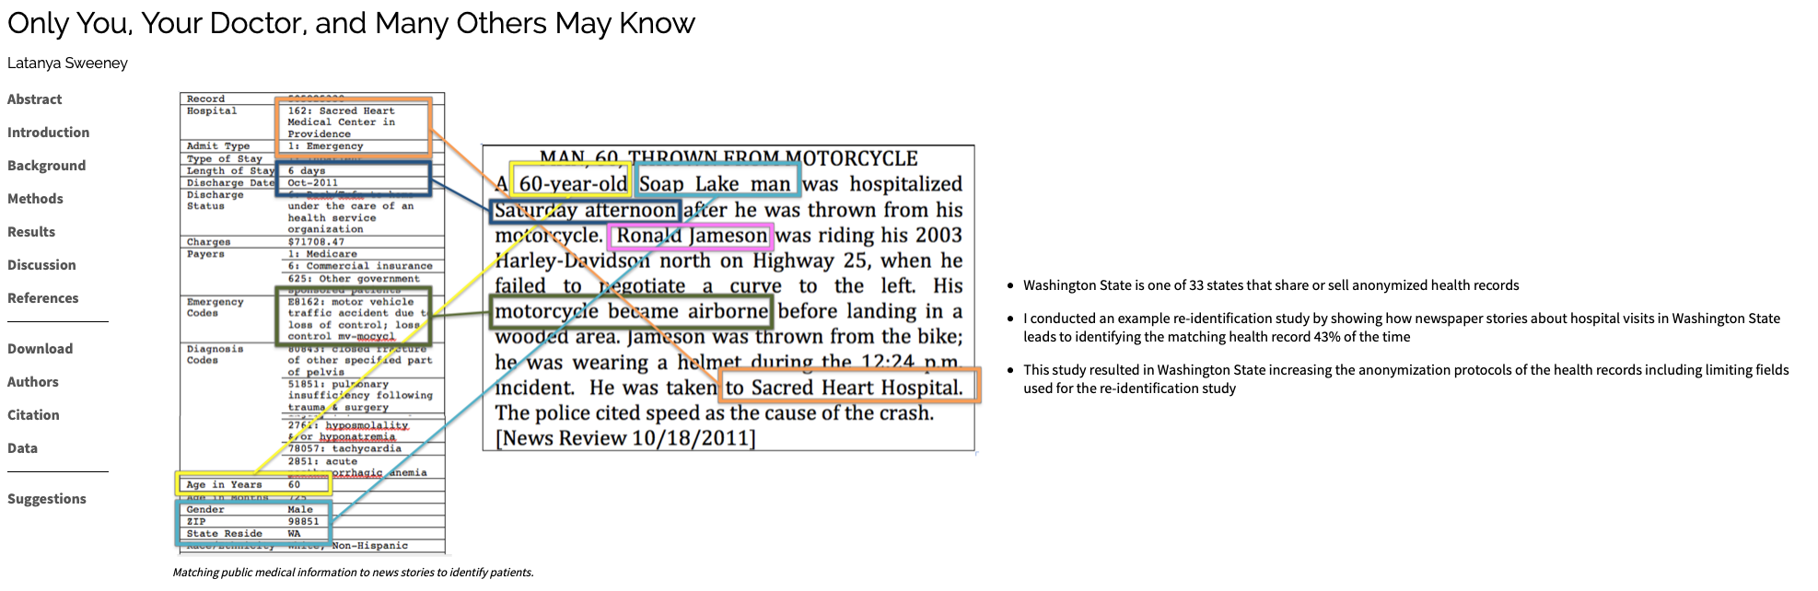
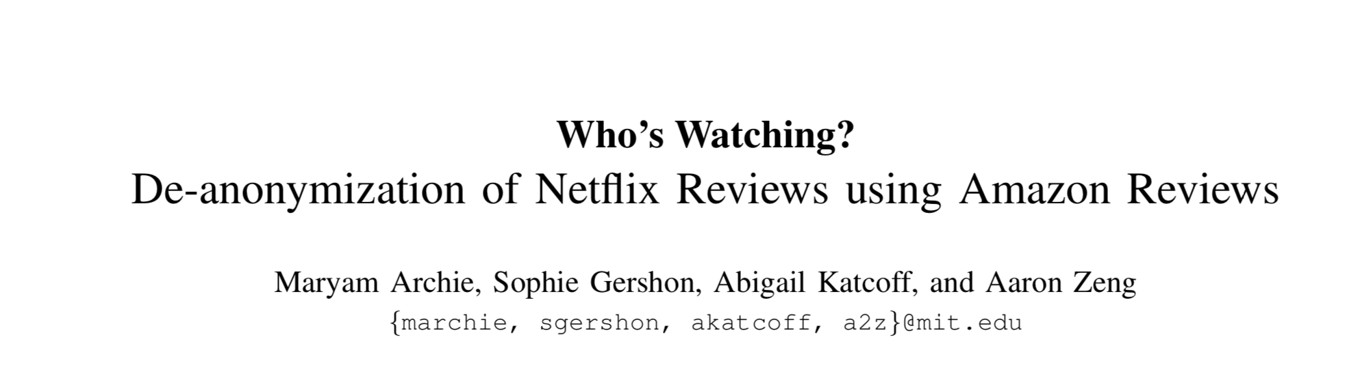
Data De-anonymization
Notes:
https://en.wikipedia.org/wiki/Data_re-identification
https://techscience.org/a/2015092903/
https://courses.csail.mit.edu/6.857/2018/project/Archie-Gershon-Katchoff-Zeng-Netflix.pdf

Slide 18
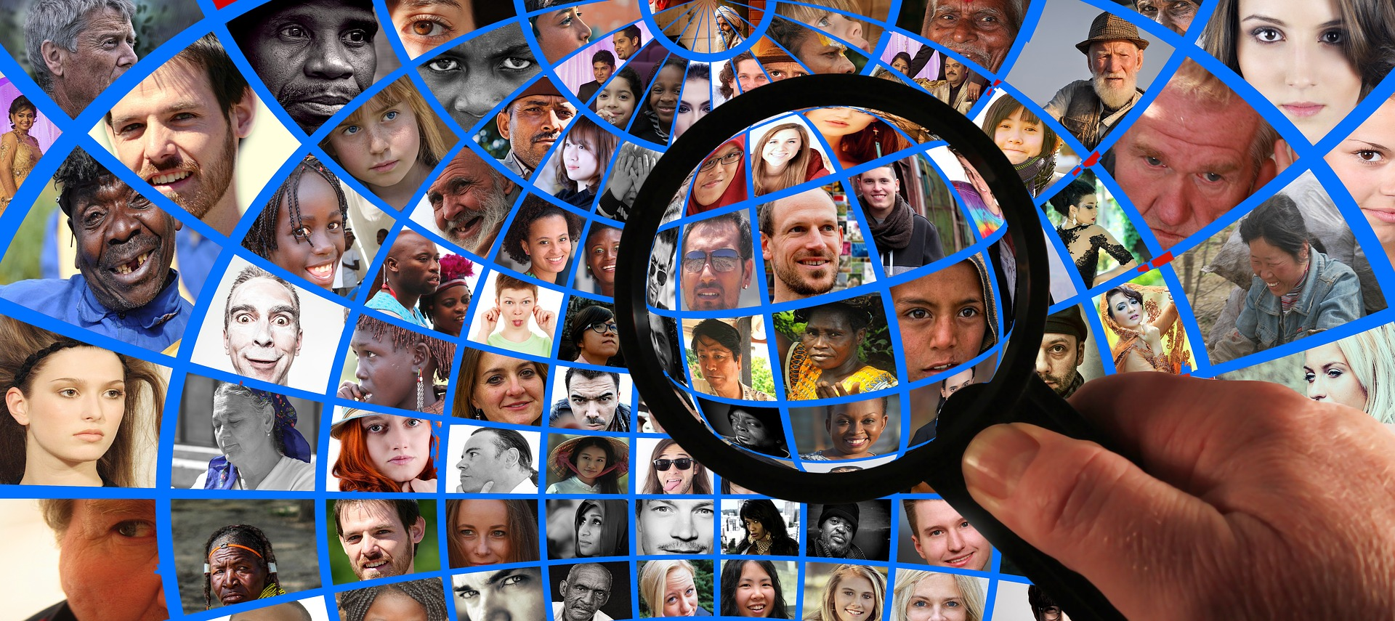
Ethics: Cambridge Analytica
Notes:
https://he.wikipedia.org/wiki/קיימברידג%27_אנליטיקה
https://youtu.be/Q91nvbJSmS4
https://www.dataviper.io/blog/2019/pdl-data-exposure-billion-people/

Slide 19
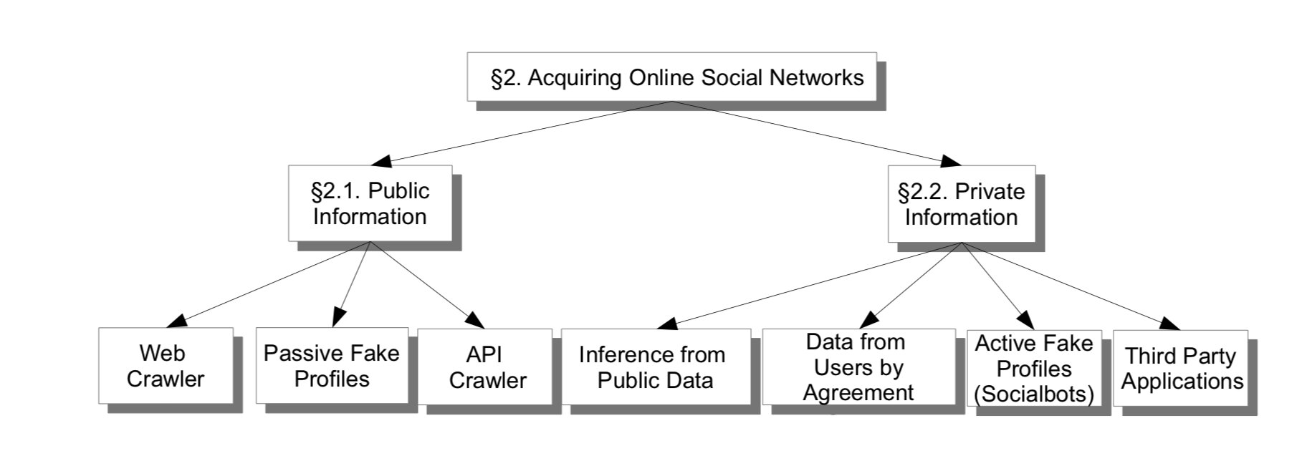
Elovici, Y., Fire, M., Herzberg, A., & Shulman, H. (2014). Ethical considerations when employing fake identities in online social networks for research. Science and engineering ethics, 20(4), 1027-1043.
Notes:
https://arxiv.org/pdf/1310.1651

Slide 20
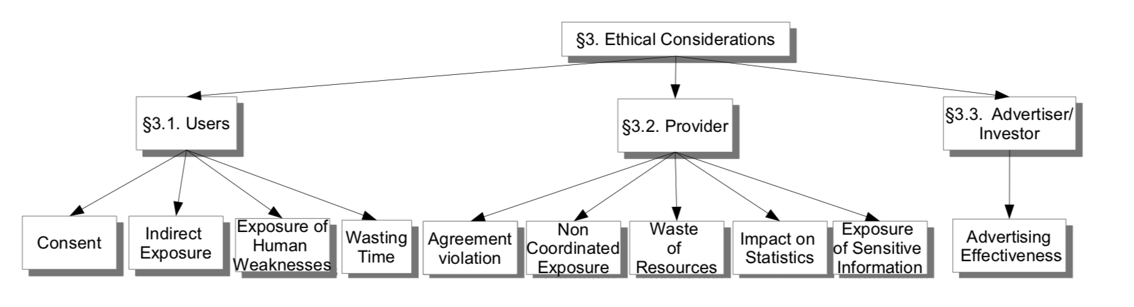
Elovici, Y., Fire, M., Herzberg, A., & Shulman, H. (2014). Ethical considerations when employing fake identities in online social networks for research. Science and engineering ethics, 20(4), 1027-1043.
Notes:
https://arxiv.org/pdf/1310.1651

Slide 21
Bias

Slide 22
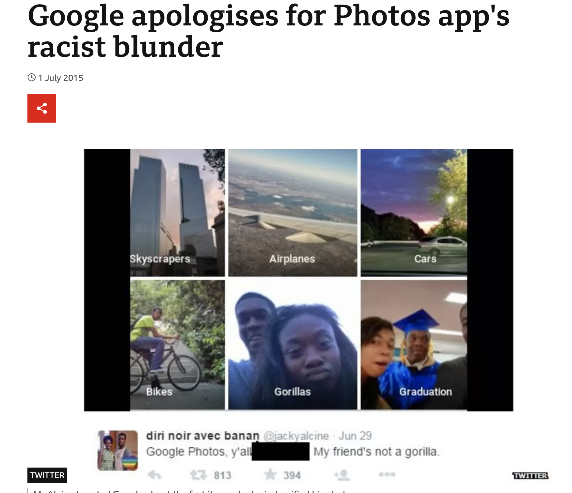
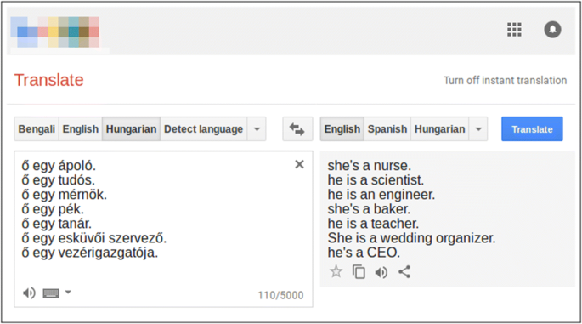
Notes:
https://link.springer.com/article/10.1007/s00521-019-04144-6

Slide 23
